Slide 1


Fundamentals of Risk Management
RM System, Process, & Program
Incident Investigation & Analysis
RM Tools & Challenges
People & Organizations
RM as Applied in Industry
Leadership in RM
Applications & Perspectives
On Becoming a
Leader in Risk Management
ENGG404 - Lecture
Chapter 6.6 An Introduction
to Occupational Health

Slide 2
Learning Outcomes:
Explain the relationship between health & safety in the workplace
Explain the importance of understanding health related risks & the role of leadership to address them
Explain the key concepts of occupational health
Explain the order of preference in controlling workplace exposures
Explain the relationship between a Health Hazards Review and a Health Risk Assessment
Describe the engineering leadership role in supporting a Health Plan
Explain the role of leadership in a Workplace Health Surveillance Program
Chapter 6.6 An Introduction to Occupational Health
2
Notes:
2

Slide 3
Introduction:
Safety and health - closely related but not the same!
Occupational Safety: injury-causing situations / acute, sudden, severe
Occupational Health: disease-causing conditions / adverse reaction to prolonged exposure to hazards
The difference is not always clear:
Stress - psychological & physiological problems over a prolonged period.
Health concern.
However, a stressed worker may be more prone to rush or unintentionally forget or overlook safety precautions & thus lead to an incident.
Safety concern.
We are responsible for both, so we need to have an appreciation of both.
Chapter 6.6 An Introduction to Occupational Health
3
Notes:
3

Slide 4
Uranium and Mining:
Canada is the world's SECOND largest producer & exporter of uranium.
Uranium - naturally-occurring radioactive material (NORM) that is mined.
Commercial uses for uranium: weapons & reactors (energy, medicine, engineering diagnostic tools, food sterilization)
Medical science 1930’s: airborne radioactivity likely causes lung cancer: mining releases radon gas (odourless, colourless, inert, half-life = 3.8 days.
Key to disease prevention – control the mine atmosphere:
Control dust and improve ventilation
Inadequate ventilation can cause contamination with dust and radon “daughters” – radiation dose right inside the lungs
There is no such thing as a "safe dose" of radiation although we live with and are immersed in background radiation
The higher incidence of lung cancer may take years to occur.
Occupational health issue!
Prolonged exposure leads to disease years and decades later!
Chapter 6.6 An Introduction to Occupational Health
4
Notes:
4

Slide 5

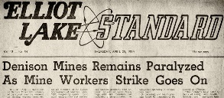
Uranium and the Elliot Lake Tragedy:
1973: “… an increasing number of miners in Elliot Lake who are starting to show the effects of dust in their lungs. When we consider that there is also radiation exposure involved, this could lead to a very dangerous situation”.
In response, Rio Tinto VP: “Menace of dust exposure in these uranium mines we believe is not yet generally understood” & “take some time before all its particular hazards are fully recognized”
Annual x-rays & medical examinations of workers; results not disclosed.
Paris Conference on uranium mining
attended by mine union members and provincial government officials; officials spoke about the harmful effects of radiation based on studies of Elliot Lake miners.
1974 – Elliot Lake Uranium miners at
Denison Mines wildcat strike to protest
unhealthy working conditions.
Chapter 6.6 An Introduction to Occupational Health
5
Notes:
5

Slide 6
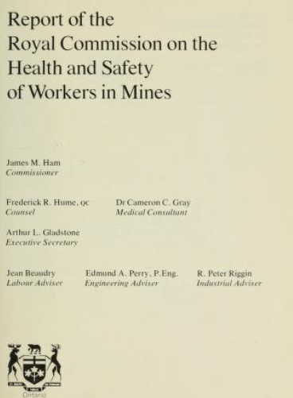
Uranium, Elliot Lake, & Ham Report Excerpts & Leadership:
The “Ham Report”:
Ontario government established the Royal
Commission the Health and Safety of Workers
in Mines (the Ham Commission 1976-June-30).
https://archive.org/details/reportofroyworkmine00onta/page/n3/mode/2up
The Ham Report criticized government & mining
companies for lacking transparency and failing to
protect 30,000 Ontario mine workers from
hazardous conditions.
Report had 117 recommendations with implications beyond Ontario.
Key outcome – Internal Responsibility System (IRS) for OHS
  Underlying philosophy of the OHS legislation in all Canadian jurisdictions: everyone in the workplace - both employees and employers - is responsible for his or her own safety and for the safety of co-workers
Chapter 6.6 An Introduction to Occupational Health
6
Notes:
6

Slide 7
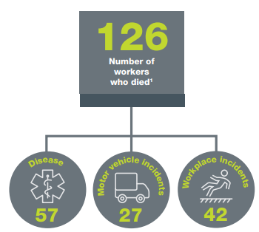
The Alberta Context:
Alberta Occupational Health and Safety Act - Excerpts:
Employers must ensure that worker exposure to a harmful substance is kept as low as reasonably practicable/reasonably achievable and does not exceed the substance’s Occupational Exposure Limit (OEL: simply, the concentration under which exposure is generally believed to not cause harm)
Specific requirements for asbestos, silica, coal dust or lead
Consequences of Exposure:
In 2018, 45% of Alberta work fatalities were
associated with an occupational disease.
Chapter 6.6 An Introduction to Occupational Health
7
Notes:
7

Slide 8
Occupational Health Hazards:
Three categories of OHH’s:
Chemical – sulphuric acid, H2S, coal dust
Physical – noise; heat/cold stress; lighting; ergonomic factors
Biological – airborne-virus, animal-borne virus; animal-borne bacteria; sanitary waste; natural pathogens
Chemical hazards - combination of concentration and duration of exposure
Biological hazards - combination of virulence of the micro-organism & extent of exposure.
Any chemical has the potential to be a toxicant (a toxic substance)
Hazardous effects depend on three main factors:
Dose i.e. how much?
Time exposure i.e. how long, how often?
Exposure routes: how is the person exposed?
Typically, as concentration increases, time decreases.
Chapter 6.6 An Introduction to Occupational Health
8
Notes:
8

Slide 9
Definitions:
Many substances have toxic properties - we need to have a basic understanding of toxicology to use these substances safely:
Toxicology: the scientific discipline that involves studying the adverse effects of chemical substances on living organisms
Toxicant: any substance that is toxic, causing harm or is fatal to living organisms
Industrial Hygiene:
Concerned with environmental factors that can lead to sickness, disease, or other forms of impaired health
Prevent or reduce entry: biological agents, chemical agents, physical agents
Industrial Hygiene surveys of work environment have four parts
Anticipation – expectation of hazard existence
Identification – presence of workplace exposure
Evaluation – magnitude of exposure
Control – reduction to acceptable levels
Chapter 6.13 An Introduction to Occupational Health
9
Notes:
9

Slide 10
Exposure Routes for Toxicants:
Exposure to hazardous substances:
Inhalation of airborne gases, vapors or particulates
Ingestion of liquids or particulates
Skin absorption after contact with liquids
ROUTE | ENTRY | CONTROL
Inhalation* | Mouth, nose | Ventilation, fume hoods, respirators, face hoods, personal protective equipment
Dermal Absorption* | Skin | Protective clothing
Injection | Cuts or punctures in skin | Protective clothing
Ingestion | Mouth, stomach | Enforcement of rules on eating, drinking, smoking
 |  | * industrially most significant but can vary for different industries
Chapter 6.6 An Introduction to Occupational Health
Notes:
10

Slide 11
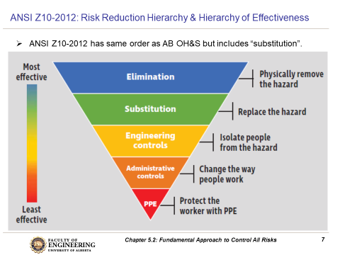
Exposure Control:
Order of preference for controlling exposure to health hazards:
Note: PPE a “last resort”
Chapter 6.6 An Introduction to Occupational Health
11
Notes:
11

Slide 12
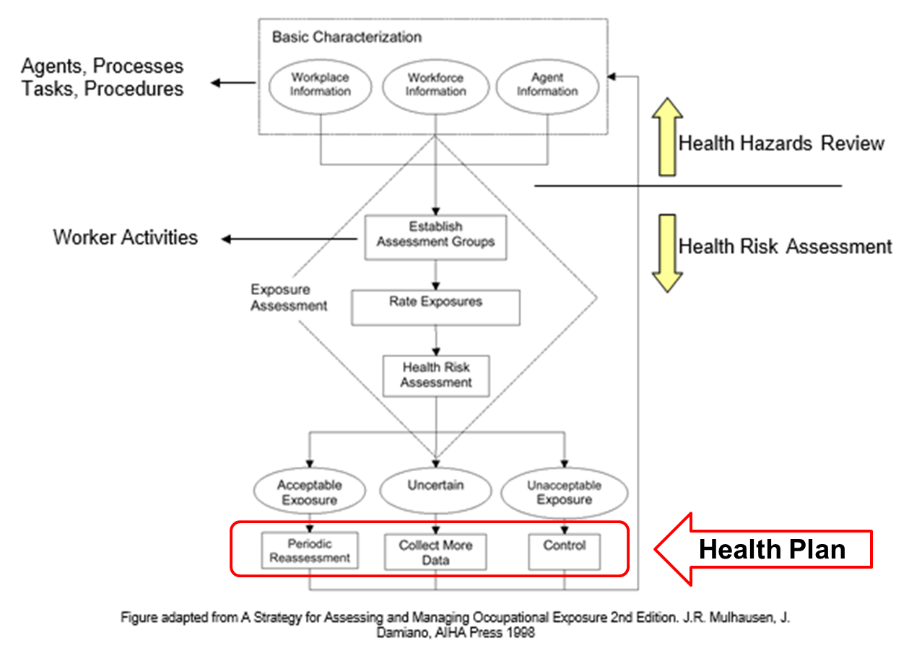
Health Exposure Methods:
Health Hazards Review and Health Risk Assessment::
Experts: Medical Scientists, Toxicologists, Epidemiologists, Industrial Hygienists
Identify hazards
Assess exposures to hazards and determine if acceptable or not
Health Plan:
Proactive organizations develop, implement, and maintain/update health plans to manage their occupational health exposures (risk)
The objectives of a health plan are to:
Prevent health incidents and adverse long-term exposures
Minimize the seriousness of injuries and illness / access to quality medical care
Integrate health control measures into facility engineering & design
What does the Health Plan do?
Periodic reassessment
Collect more data
Implement controls
As engineers (as leaders and designers),
what could be our role in supporting a Health
Plan within our facilities and operations?
Chapter 6.6 An Introduction to Occupational Health
12
Notes:
12

Slide 13
ALE #2: Supporting a Health Plan
Please confer (pen-to-paper, respond on MM-Poll):
Consider any kind of material(s) that would be handled or used or manufactured in your engineering discipline. As engineers (as leaders and designers), what could be our role in supporting a Health Plan?
Incorporate inherently safer design principles into our engineering work
Conduct an industrial hygiene survey when the facility is operational
Incorporate health considerations into the MOC process
Establish an electronic system to maintain safety data sheets on site
Incorporate health considerations into the scope of risk assessments
Chapter 6.6 An Introduction to Occupational Health
13
Notes:
13

Slide 14
Example: Supporting a Health Plan
We can support a Health Plan :
Incorporate inherently safer design principles into our engineering work
Conduct an industrial hygiene survey when the facility is operational
Incorporate health considerations into the MOC process
Establish an electronic system to maintain safety data sheets on site
Incorporate health considerations into the scope of risk assessments
Chapter 6.6 An Introduction to Occupational Health
14
Notes:
14

Slide 15
Workplace Health Surveillance Programs:
WHSP’s can be implemented:
As required per regulatory requirements
Voluntarily to inform management
Examples: hearing conservation, respiratory protection, medical surveillance guidelines for benzene chemical exposure
Key Objective of a WHSP:
Provide guidance to management for further investigation or action based upon the identification of trends suggesting a potential adverse health effect
Leadership role - support WHSP’s:
provide resources,
provide access,
be transparent,
take action to address issues.
Chapter 6.6 An Introduction to Occupational Health
15
Notes:
15

Slide 16
Summary:
The terms health & safety are related but there are important distinctions between them
Leadership understanding of health related risks associated with our activities is required for us to prevent and/or control these exposures
Like other workplaces hazards, we have an order of preference for addressing potential worker health exposures
We can use a Health Hazards Review and a Health Risk Assessment to define a health exposure assessment strategy
As engineers, we have a leadership role in supporting the development of a Health Plan
Organizations employ Workplace Health Surveillance Programs as part of their ongoing worker monitoring efforts; and require leadership support.
Chapter 6.6 An Introduction to Occupational Health
16
Notes:
16

Slide 17
Any questions?
Notes:
17

Slide 18
Complete Slide Deck follows with details.
18
Notes:
18

Slide 19
Fundamentals of Risk Management
RM System, Process, & Program
Incident Investigation & Analysis
RM Tools & Challenges
People & Organizations
RM as Applied in Industry
Leadership in RM
Applications & Perspectives
On Becoming a
Leader in Risk Management
ENGG404 - Lecture
Chapter 6.6 An Introduction
to Occupational Health

Slide 20
Learning Outcomes:
Explain the relationship between health & safety in the workplace
Explain the importance of understanding health related risks & the role of leadership to address them
Explain the key concepts of occupational health
Explain the order of preference in controlling workplace exposures
Explain the relationship between a Health Hazards Review and a Health Risk Assessment
Describe the engineering leadership role in supporting a Health Plan
Explain the role of leadership in a Workplace Health Surveillance Program
Chapter 6.6 An Introduction to Occupational Health
20
Notes:
20

Slide 21
Introduction:
Safety and health - closely related but not the same!
“Occupational Safety”:
Concerned with injury-causing situations
Exposure to acute, sudden, severe conditions
“Occupational Health”:
Concerned with disease-causing conditions
Adverse reaction to prolonged exposure to hazards
The difference is not always clear:
Stress, a hazard, can cause both psychological & physiological problems over a prolonged period.
Health concern.
However, a stressed worker may be more prone to rush or unintentionally forget or overlook safety precautions & thus lead to an incident.
Safety concern.
We are responsible for both, so we need to have an appreciation of both.
Chapter 6.6 An Introduction to Occupational Health
21
Notes:
21

Slide 22
Uranium and Mining:
Canada is the world's SECOND largest producer & exporter of uranium.
Uranium - naturally-occurring radioactive material (NORM) that is mined.
Two commercially important uses for uranium: weapons & reactors (energy, medicine, engineering diagnostic tools, food sterilization)
Airborne radioactivity in mines likely caused lung cancer (1930s science pub’ns)
While mining, radioactive radon gas is released into the mine atmosphere.
Radon is odourless, colourless, inert, & has a short half-life (3.8 days).
Key to disease prevention – mine atmosphere:
Control dust levels containing silicosis particles & radon gas.
Inadequate ventilation (engineering control) can cause contamination with dust and radon “daughters”. Tiny dust particles can lodge in the miners' lungs and deliver a dose of radiation.
There is no such thing as a "safe dose" of radiation although we live with and are immersed in background radiation
The higher incidence of lung cancer may take years to occur.
Occupational health issue!
Prolonged exposure leads to disease years and decades later!
Chapter 6.6 An Introduction to Occupational Health
22
Notes:
22

Slide 23
Uranium and the Elliot Lake Tragedy:
By 1958, 11 uranium mines; 23% of all mining activity in Ontario; (several boom & bust cycles with last mine closing in 1996)
1973: a union representative noted “an increasing number of miners in Elliot Lake who are starting to show the effects of dust in their lungs. When we consider that there is also radiation exposure involved, this could lead to a very dangerous situation”.
In response, Rio Tinto VP: “Menace of dust exposure in these uranium mines we believe is not yet generally understood” & “take some time before all its particular hazards are fully recognized”
Annual x-rays & medical examinations of workers; results not disclosed.
Paris Conference on uranium mining
attended by mine union members and provincial government officials; officials spoke about the harmful effects of radiation based on studies of Elliot Lake miners.
1974 – Elliot Lake Uranium miners at
Denison Mines staged a wildcat strike
to protest unhealthy working conditions.
Chapter 6.6 An Introduction to Occupational Health
23
Notes:
23

Slide 24
Uranium, Elliot Lake, & Ham Report Excerpts & Leadership:
The “Ham Report”:
Strike led Ontario government to establish the
Royal Commission the Health and Safety of Workers
in Mines (the Ham Commission 1976-June-30).
https://archive.org/details/reportofroyworkmine00onta/page/n3/mode/2up
The Ham Commission Report criticized
government & mining companies for lacking
transparency and failing to protect 30,000
Ontario mine workers from hazardous conditions.
Report had 117 recommendations with implications beyond Ontario.
Key outcome – Internal Responsibility System (IRS) for OHS
  Underlying philosophy of the OHS legislation in all Canadian jurisdictions: everyone in the workplace - both employees and employers - is responsible for his or her own safety and for the safety of co-workers
Chapter 6.6 An Introduction to Occupational Health
24
Notes:
24

Slide 25
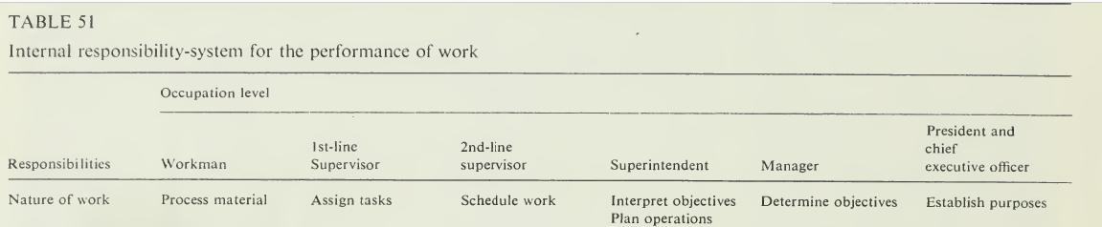
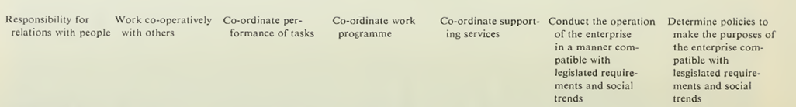
Uranium, Elliot Lake, & Ham Report Excerpts & Leadership:
  The Internal Responsibility System!
  Eight (8) sets of responsibilities over six (6) levels of occupation within the organization
  The Ham Report was a game-changer for initiating internal performance driven not only on legislation but also on social trends
  Leadership gets the impetus to “change culture” of the organization;
  thus “leadership in risk management” is essential for an IRS!
Chapter 6.6 An Introduction to Occupational Health
25
Notes:
25

Slide 26

The Burden of Occupational Cancer in Canada:
Occupational Cancer Research Center (OCRC) 2019 Report
Collectively, exposure to cancer causing agents in the workplace cause approx. 10,000 cancers in Canada each year
Solar radiation: Approx. 1.4 million
Canadian workers are exposed, causing
an estimated 4600 non-melanoma skin
cancer cases per year
Asbestos: More than 150,000 workers are
exposed but it is estimated to cause 1900
lung cancers, 430 mesotheliomas, 45
laryngeal cancers annually
Diesel engine exhaust: About 897,000
workers are exposed every year & it
accounts for 560 lung & 200 suspected bladder cancers annually
Crystalline silica: an estimated 382,000 workers are exposed which causes almost 570 cases of lung cancer each year
Chapter 6.6 An Introduction to Occupational Health
26
Notes:
26

Slide 27
The Alberta Context:
Alberta Occupational Health and Safety Act - Excerpts:
A hazard has the potential to cause an injury, illness or loss
Employers must ensure that worker exposure to a harmful substance is kept as low as reasonably practicable/reasonably achievable and does not exceed the substance’s Occupational Exposure Limit (OEL)
Specific requirements in place for situations where asbestos, silica, coal dust or lead are present at a work site
Note: OEL is based on the principle that
for each substance there is a safe or
tolerable level of exposure below which no
significant adverse health effects are likely
to occur
Consequences of Exposure:
In 2018, 45% of Alberta work fatalities were
associated with an occupational disease, a
result of prolonged and long-term exposure to
hazardous substances during their careers.
Chapter 6.6 An Introduction to Occupational Health
27
Notes:
27

Slide 28
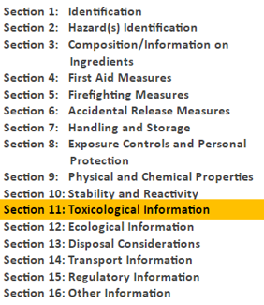
Safety Data Sheets (or Material Safety Data Sheets):
SDS is a common, valuable, and essential source of information about the hazardous properties of materials
Chapter 6.6 An Introduction to Occupational Health
28
Notes:
28

Slide 29
Occupational Health Definitions:
Many substances have toxic properties - we need to have a basic understanding of toxicology to use these substances safely:
Toxicology: the scientific discipline that involves studying the adverse effects of chemical substances on living organisms
Toxicant: any substance that is toxic – can cause harm or is fatal to living organisms
Industrial Hygiene:
Technical discipline concerned with environmental factors that can lead to sickness, disease, or other forms of impaired health
Prevent or reduce entry: biological agents, chemical agents, physical agents
Industrial Hygiene surveys of work environment have four parts
Anticipation – expectation of hazard existence
Identification – presence of workplace exposure
Evaluation – magnitude of exposure
Control – reduction to acceptable levels
Chapter 6.6 An Introduction to Occupational Health
29
Notes:
29

Slide 30
Occupational Health Hazards:
Occupational health hazards are generally grouped into three categories:
Chemical hazards - sulphuric acid, H2S, coal dust
Physical – noise; heat/cold stress; lighting; hard human factors (human-machine interface i.e. ergonomics)
Biological – airborne, animal borne; virus, bacteria; sanitary waste; natural pathogens
Chemical hazards are generally defined by a combination of concentration and duration of exposure
Biological hazards are generally defined by a combination of virulence of the micro-organism & extent of exposure. Some micro-organisms are considered hazardous at any level of exposure.
Chapter 6.6 An Introduction to Occupational Health
30
Notes:
30

Slide 31
Occupational Health Hazards:
Any chemical has the potential to be a toxicant (a toxic substance)
Hazardous effects depend on three main factors:
Dose: the concentration of the toxic substance during exposure
Time of Exposure: for how long was the persons exposed to the toxic substance and how often the persons are exposed
Exposure routes: the manner in which the person was exposed to the toxic substance
Exposure to hazardous chemicals & biological agents is usually by inhalation of airborne gases, vapors or particulates, ingestion of liquids or particulates, or skin absorption after contact with liquids
Chapter 6.6 An Introduction to Occupational Health
31
Notes:
31

Slide 32
Dose:
Effective Dose: concentration of a substance
required to cause a health effect that is minor
and reversible (such as minor skin or eye irritation)
Toxic Dose: concentration of a substance required
to cause a health effect that is irreversible but not lethal
Lethal Dose: concentration of a substance being
tested which will kill a test animal
Effective
Toxic
Lethal
Chapter 6.6 An Introduction to Occupational Health
32
Notes:
32

Slide 33
Occupational Exposure Limits (OEL) Terminology (Duration):
Occupational Exposure Limits (OEL):
Limits are based on the principle that each substance has a safe, tolerable level of time-based exposure below which no significant adverse health effects are likely to occur
Developed to communicate hazardous conditions and to protect the workers against exposure to harmful substances or situations. The goal and basis are:
No harmful effect over working lifetime.
Based on science: epidemiology or toxicological studies, and what is reasonably achievable by the industry.
The limits are “escalating”:
Threshold Limit Value (TLV):
The maximum concentration of a substance that an individual
can be exposed to without experiencing adverse effects.
Threshold Limit Value-time Weighted Average (TLV-TWA):
The concentration for a conventional 8-hour workday and a
40-hour workweek, to which it is believed that nearly all workers
may be repeatedly exposed, day after day, for a working lifetime
without adverse effect.
TLV
– no harm
TLV-TWA
– no harm
Chapter 6.6 An Introduction to Occupational Health
33
Notes:
33

Slide 34
Occupational Exposure Limits (OELs) – Terminology:
Threshold Limit Short Term Exposure Limit (TLV-STEL):
The concentration of a chemical that should not be exceeded
for more than 15 minutes during a workday. At or beyond this
concentration, a worker exposed for a 15-minute period may
suffer irritation, potentially irreversible tissue damage, toxic
effects, or mental impairment.
Threshold Limit Value – Ceiling (TLV-C):
The concentration that should not be exceeded during any
part of working exposure.
Immediately Dangerous to Life and Health (IDLH):
The atmospheric concentration of any toxic, corrosive, or
asphyxiating substance that poses an immediate threat to
life or would cause irreversible or delayed adverse health
effects, or would interfere with an individuals ability to
escape from a dangerous atmosphere.
TLV-STEL
TLV-C
IDLH
– fatal
Chapter 6.6 An Introduction to Occupational Health
34
Notes:
34

Slide 35
Exposure Routes for Toxicants:
Exposure to hazardous chemicals & biological agents is usually by:
Inhalation of airborne gases, vapors or particulates
Ingestion of liquids or particulates
Skin absorption after contact with liquids
ROUTE | ENTRY | CONTROL
Inhalation* | Mouth, nose | Ventilation, fume hoods, respirators, face hoods, personal protective equipment
Dermal Absorption* | Skin | Protective clothing
Injection | Cuts or punctures in skin | Protective clothing
Ingestion | Mouth, stomach | Enforcement of rules on eating, drinking, smoking
 |  | * industrially most significant but can vary for different industries
Chapter 6.6 An Introduction to Occupational Health
Notes:
35

Slide 36
Toxicants and Effects:
Our response to toxicants covers a spectrum
Allergic reactions
Immediate vs delayed toxicity (carcinogens)
Local vs systemic (target organs)
Effects that are irreversible:
Carcinogen - causes cancer (asbestos, radon, vinyl chloride)
Mutagen - causes chromosome damage (x-rays, UV radiation)
Reproductive hazard - causes damage to reproductive system (radiation)
Teratogen - causes birth defects (rubella, PCBs)
Effects that may or may not be reversible:
Dermatotoxic - affects skin (methylene chloride)
Hemotoxic - affects blood (ethylene-oxide, glycol ethers)
Hepatotoxic - affects liver (organic solvents)
Nephrotoxic - affects kidneys (heavy metals – mercury, cadmium)
Neurotoxic - affects nervous system (lead, n-hexane)
Pulmonotoxic - affects lungs (phosgene, chlorine, ammonia)
Chapter 6.6 An Introduction to Occupational Health
36
Notes:
36

Slide 37
Exposure Control:
The order of preference for controlling exposure to occupational health hazards is as follows
Eliminate the chemical or biological agent
Substitute a less hazardous chemical or biological agent
Engineering controls to prevent exposure of people to the occupational health hazard
Administrative controls to control exposure, mitigate exposure,
or prevent exposure
Personal protective equipment
Note: PPE a “last resort” & is
reserved for situations where
other control methods are either
unknown, inadequate, or where
it is impracticable to reduce
exposure below occupational
exposure limits.
Chapter 6.6 An Introduction to Occupational Health
37
Notes:
37

Slide 38
ALE #1: Apply Hierarchy of Controls for Asbestos
Please confer (pen-to-paper, respond on Zoom-Chat-Open):
Consider a small insulation company that specializes in the removal of legacy construction materials that contain asbestos (wallboard, insulation, concrete). What can you do to control or mitigate exposure to asbestos particles?
Prefix your response with
“E”, “S”, “EC”, AC”, or “PPE”.
Chapter 6.6 An Introduction to Occupational Health
38
Notes:
38

Slide 39
Man-Made Mineral Fibres – Are They Better?
Man-Made Mineral Fibres: substituted for asbestos.
Were developed to replace asbestos, a known carcinogen
Includes fibrous glass (glass, wool, glass filament), ceramic fibre (alumina silicate) and mineral wool (glass, rock and slag wools)
MMMF Dust:
Generally about 10x the diameter of asbestos fibres;
Cannot be split along their length into thinner fibres (asbestos splits)
Thus, MMMF dust does not reach the deep lung spaces (alveoli) whereas asbestos fibres can reach deeply
Majority is filtered in the upper respiratory system; coughed up and ingested
Traditionally considered a nuisance dust i.e. short term exposure; irritation to the skin, eyes, nose, throat, lungs
Inhalation is the primary long term health concern (chronic exposure) and MMF dust is considered a possible carcinogen for humans
Thus substituting MMMF for asbestos still has a potential health exposure (risk is not zero).
Long-term monitoring and research are needed to resolve this question.
Chapter 6.6 An Introduction to Occupational Health
39
Notes:
39

Slide 40
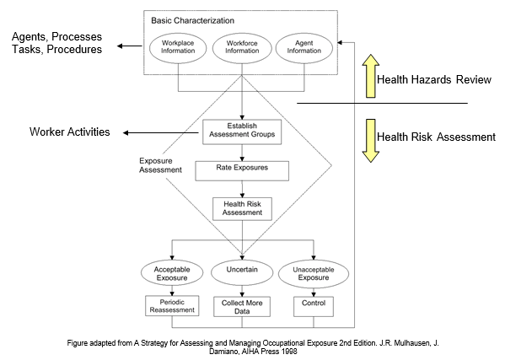
A Generic Health Exposure Assessment Flowchart:
Health Plan
Chapter 6.6 An Introduction to Occupational Health
Notes:
40

Slide 41
Health Exposure Methods:
Health Hazards Review and Health Risk Assessments:
Experts: Medical Scientists, Toxicologists, Epidemiologists, Industrial Hygienists
Health Hazards Review:
Provides information on agents, equipment, and processes
This review along with personnel and tasks information is used to establish assessment (exposure) groups
These assessment groups are workers who conduct similar activities at a particular operating site or location that may result in similar health risks
Exposure ratings are based on exposure intensity (dose), duration, and frequency
Health Risk Assessment:
uses exposure estimates or measured exposures to risk rank the hazardous scenarios
may provide additional recommendations for hazard mitigation.
Chapter 6.6 An Introduction to Occupational Health
41
Notes:
41

Slide 42
Health Exposure Methods:
Health Plan:
Proactive organizations develop, implement, and maintain/update health plans to manage their occupational health exposures (risk)
The objectives of a health plan are to:
Prevent health incidents and adverse long-term exposures associated with the activities of the organization
Minimize the seriousness of injuries and illness by having access to quality medical care
Integrate health control measures into facility engineering & design
A Health Plan includes:
Periodic reassessment of acceptable
risk exposures
Collect more data where risk exposure
levels are uncertain
Develop and implement control measures to
reduce exposure levels to acceptable levels.
As engineers (as leaders and designers),
what could be our role in supporting a Health
Plan within our facilities and operations?
Chapter 6.6 An Introduction to Occupational Health
42
Notes:
42

Slide 43
Example: Supporting a Health Plan
Engineers can support a Health Plan :
Incorporate inherently safer design principles into our engineering work
Conduct an industrial hygiene survey when the facility is operational
Incorporate health considerations into the MOC process
Establish an electronic system to maintain safety data sheets on site
Incorporate health considerations into the scope of risk assessments
Chapter 6.6 An Introduction to Occupational Health
43
Notes:
43

Slide 44
Noise Exposure:
Workers may sometimes be required to work in areas where noise levels and duration cause exposures which exceed occupational exposure limits
85 dBA is often considered the level where workers may be noise exposed
Engineering controls to reduce high noise levels include silencers, barriers, enclosures, acoustical cladding, isolation
dBA: a measure of sound pressure level according to the A weighting scale of a sound level meter (the A scale is designed to respond to noise in a similar manner to the human ear)
Noise Level Survey: using a sound level meter to measure noise levels in different areas
Noise Dosimetry: personal monitoring of worker’s actual noise exposure accumulated throughout their shift
Chapter 6.6 An Introduction to Occupational Health
44
Notes:
44

Slide 45
Working in Extreme Temperatures:
Environmental and Work-Specific:
Environmental – ambient, inclement weather:
Southern Alberta may exceed 40˚C in the summer
Anywhere in Alberta may drop below -40˚C in winter
Specific work spaces e.g. boiler rooms, fired equipment, mines, freezers, cryogenic equipment, refrigeration equipment, confined spaces, co-gen plants:
Thermal extremes and excesses effect the comfort & safety of workers
The body functions best within a narrow body temp range (36C – 38C)
Humans work comfortably within a narrow range (10C – 25C)
Hyperpyrexia: occurs when a combination of factors result in body temperature above 38˚C. Symptoms vary from fatigue to even a coma
Hypopyrexia: occurs when a combination of factors result in body temperature below 38˚C. Symptoms vary from fatigue, weakness and shivering to unconsciousness and death.
Chapter 6.6 An Introduction to Occupational Health
45
Notes:
45

Slide 46
Biological – Natural and Anthropogenic:
Natural Environment and Workplace-Specific:
Environmental – natural sources:
Insect-borne and animal-borne diseases
Decomposition in nature, a natural process
Typically affects workers who work outdoors in a natural environment
Specific work places – can be natural and anthropogenic:
Food processing and refrigeration – mould, mildew
Disaster Rehabilitation – black mould
Medical environments
Sanitary waste treatment
Chapter 6.6 An Introduction to Occupational Health
46
Notes:
46

Slide 47
Workplace Health Surveillance Programs:
Workplace health surveillance programs can be implemented in accordance with regulatory requirements, or voluntarily to gain information and inform management on on-going managed risks or emerging risks
Examples: hearing conservation, respiratory protection, medical surveillance guidelines for benzene chemical exposure
Objectives of health surveillance include:
Identify physiological indicators attributable to potential exposures
Detect early adverse health effects
Provide health information and counselling
Provide an ongoing database for epidemiological assessment of worker health trends
Provide guidance to management for further investigation or action based upon the identification of trends suggesting a potential adverse health effect of a potentially harmful substance
Leadership can play a significant role here by supporting WHSP’s: provide resources, provide access, be transparent about the activities and findings, take action to address issues.
Chapter 6.6 An Introduction to Occupational Health
47
Notes:
47

Slide 48
Summary:
The terms health & safety are related but there are important distinctions between them
Leadership understanding of health related risks associated with our activities is required for us to prevent and/or control these exposures
Like other workplaces hazards, we have an order of preference for addressing potential worker health exposures
We can use a Health Hazards Review and a Health Risk Assessment to define a health exposure assessment strategy
As engineers, we have a leadership role in supporting the development of a Health Plan
Organizations employ Workplace Health Surveillance Programs as part of their ongoing worker monitoring efforts; and require leadership support.
Chapter 6.6 An Introduction to Occupational Health
48
Notes:
48

